Slide 1
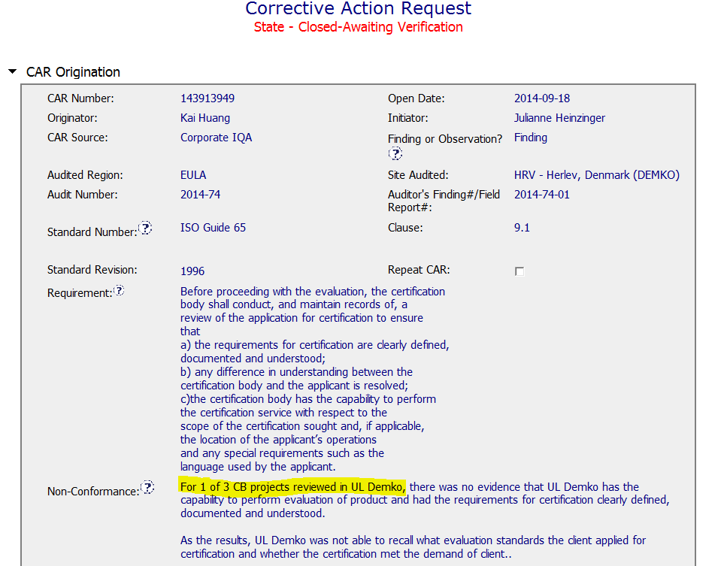
CAR 143913949 - Finding
Clear description of nonconformance – Number of projects sampled included as appropriate.

Slide 2
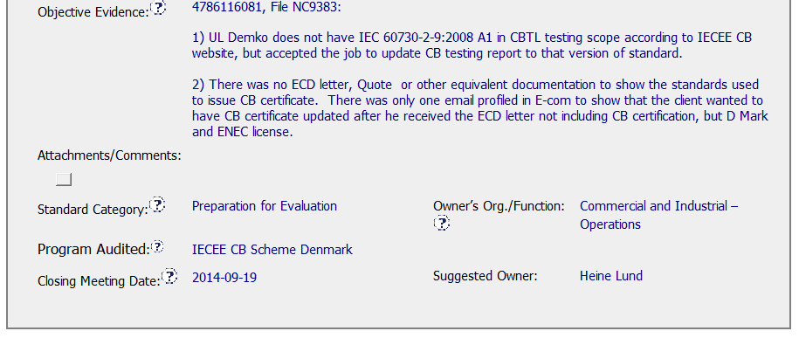
CAR 143913949 - Finding
Clearly identified objective evidence against requirement

Slide 3
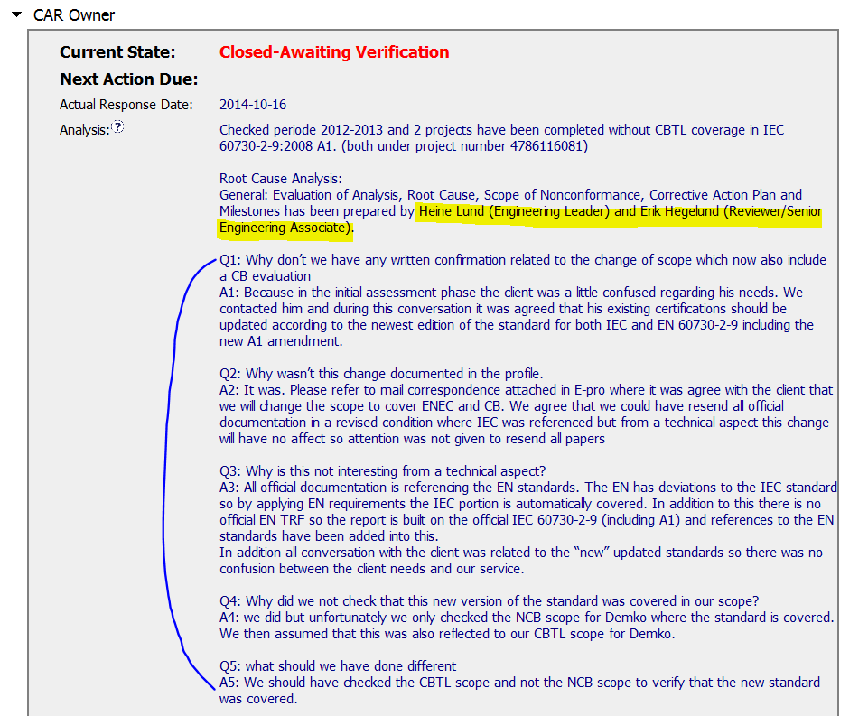
CAR 143913949 - Finding
Based on horizontal deployment, risk impact analysis was conducted and found as good.
1. 5-why technique introduced for root cause investigation
2. Analysis shows clear path to root cause
Key stakeholders identified
[Competitiveness] (C) – Analysis shows clear path to root cause and scope and stakeholders identified.

Slide 4
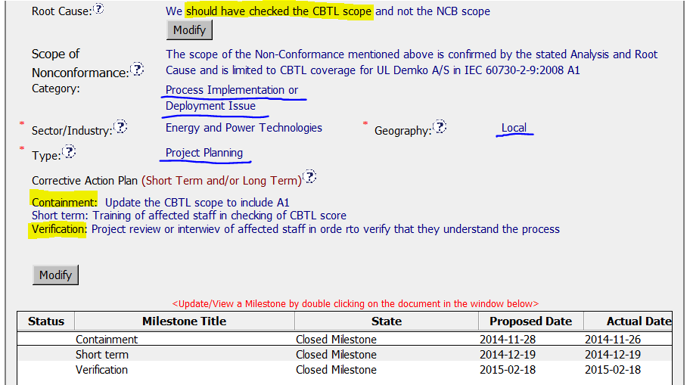
CAR 143913949 - Finding
Root cause simple, reasonable and complete.
But I’d recommend to address clear reason from analysis
Appropriate ‘category’, ‘geography, ‘type’ are selected as well.
Containment to fix objective evidence and owner’s verification to implement corrective action taken
(T) Most appropriate ‘category’, ‘type’, ‘geography’ are selected – Excellent
(C) Root cause statement is succinct, reasonable, complete (Shows ‘N/A’ for observations) – Excellent
(C) Corrective actions fix the objective evidence and other problems found; address entire root cause and scope – Excellent
(C) Milestones address containment & owner’s verification – Excellent

Slide 5
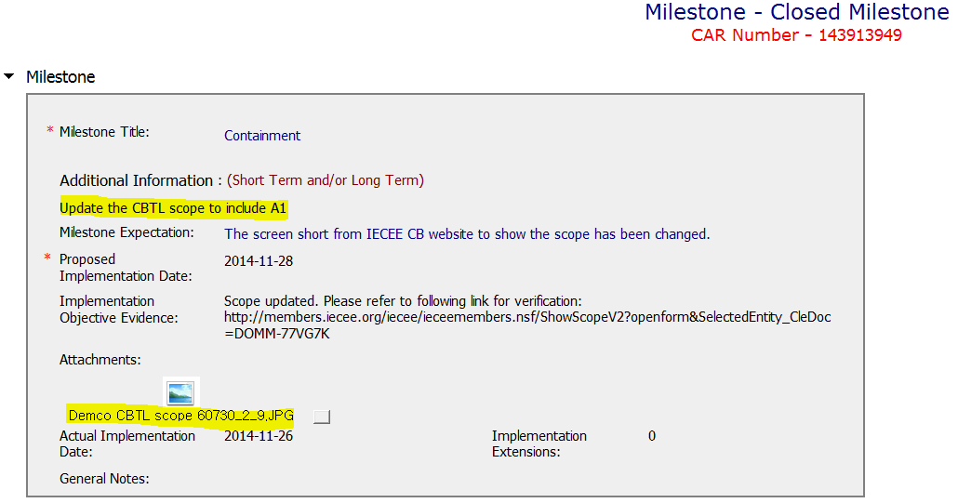
CAR 143913949 - Finding
1. Milestone completed per milestone expectation
2. Objective evidence attached as good
(C) Milestones completed per milestone expectations - Excellent

Slide 6
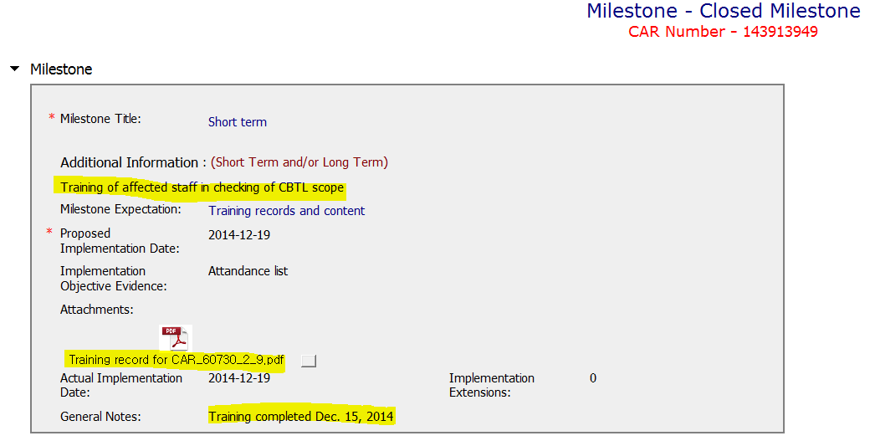
CAR 143913949 - Finding
1. Milestone completed per milestone expectation
2. Objective evidence attached as good
Additional verification comment in regard to evidence as excellent
(C) Milestones completed per milestone expectations - Excellent

Slide 7
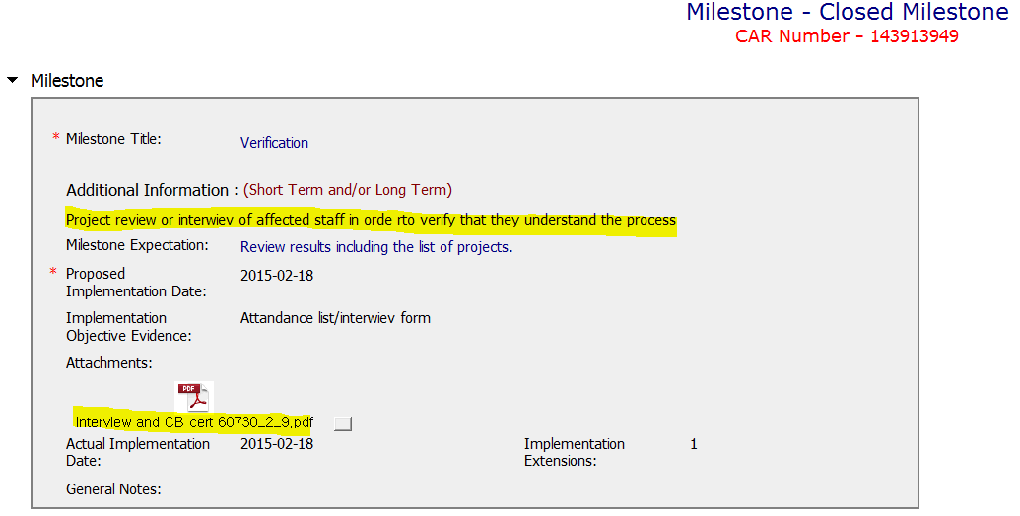
CAR 143913949 - Finding
1. Milestone completed per milestone expectation
2. Objective evidence attached as good
(C) Milestones completed per milestone expectations - Excellent

Slide 8
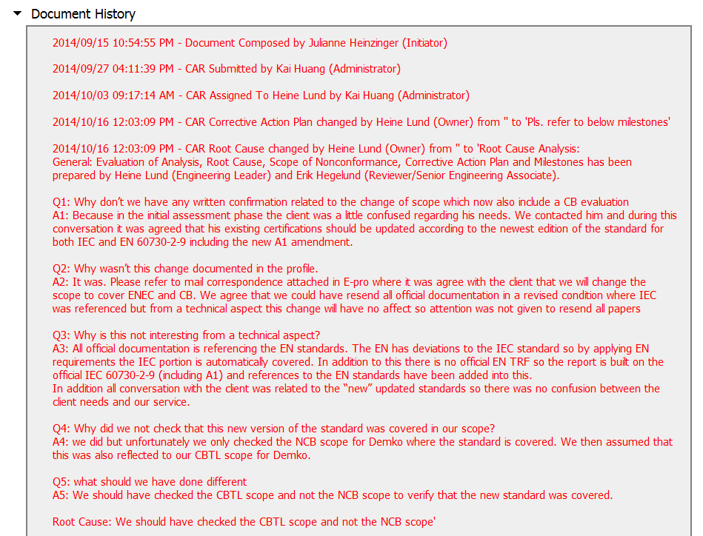
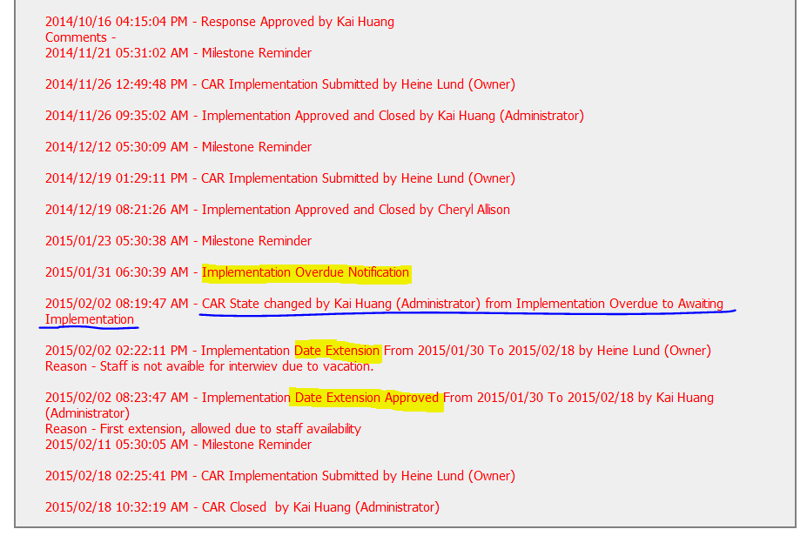
CAR 143913949 - Finding
I’d recommend to communicate with CAR owner more often to prevent overdue status and so add additional communication as evidence
(T) Acts on CARs within required timeframe
(C) Extensions are within requirement (<30 days, 3 or less)

Slide 9
CAR 143913949 – CBS Check
CBS Requirements | Excellent | Moderate | Need Improve | N/A
(C) Extensions are within requirement (<30 days, 3 or less) |  | X
(T) Most appropriate ‘category’, ‘type’, ‘geography’ are selected | X
(P) Facilitates the handling of disputed CARs |  |  |  | X
(T) Acts on CARs within required timeframe |  | X
(C) Analysis shows clear path to root cause and scope; stakeholders identified | X
(C) Root cause statement is succinct, reasonable, complete (Shows ‘N/A’ for observations) | X
(C) Corrective actions fix the objective evidence and other problems found; address entire root cause and scope. For observations, they do not go beyond fixing the objective evidence | X
(C) Milestones address containment & owner’s verification; completed per milestone expectations | X
(P) Verification per requirements | X
(L) Referenced communications are attached as needed |  |  |  | X
(C L) Evidence of communication for overdue/escalated CARs and other pertinent concerns |  | X
(P) Trains other CAR Champions |  |  |  | X

